Slide 1
COMPUTER ORGANIZATION AND ARCHITECTURE
Dr. Rizwan Khan
Head – Department of Computer Science and Engineering
(An NBA Accredited Program)
ABES Institute of Technology, Ghaziabad

Slide 2
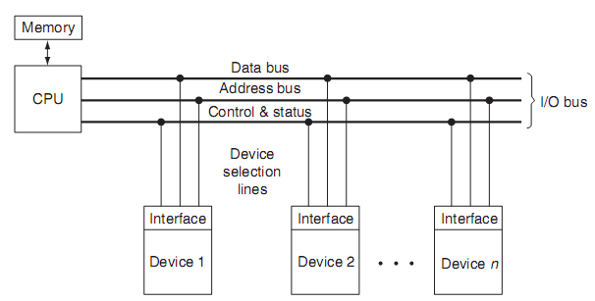
ISOLATED I/O
Isolated I/O
- Separate I/O read/write control lines in addition to memory read/write control lines
- Separate (isolated) memory and I/O address spaces
Distinct input and output instructions
Memory address values are not affected by interface register assignment

Slide 3
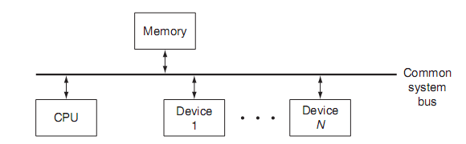
Memory Mapped IO
Both the memory and I/O devices are connected to the CPU through the same bus
The device addresses are a part of the memory address space.
The load and store instructions used with memory operands can be used as the read and write instructions with respect to those addresses conﬁgured for I/O devices.
Separate I/O instructions are not needed
Some of the memory address space is used up by the I/O, and it can be difﬁcult to distinguish between the memory and I/O – oriented operations in a program.

Slide 4
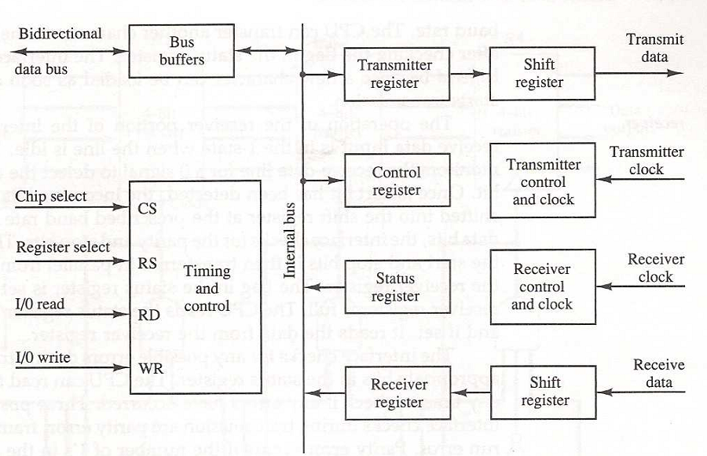
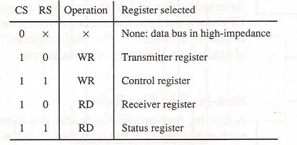
Asynchronous Communication Interface

Slide 5
I/O INTERFACE
Input/Output Interfaces
Port A
I/O data
register
Bidirectional
Bus
data bus
buffers
I/O data
Port B
register
CPU
Chip select
I/O
Device
Register select
CS
Internal bus
Control
Control
Register select
RS1
Timing
register
RS0
and
I/O read
Control
Status
Status
I/O write
RD
WR
register
CS RS1 RS0 Register selected
0 x x None - data bus in high-impedence
1 0 0 Port A register
1 0 1 Port B register
1 1 0 Control register
1 1 1 Status register
The interface may work with an I/p, an o/p or an I/o device.
A command is passed to the I/O device by sending a word to the appropriate interface register.
The transfer of data, control and status information is always via the common data bus, the distinction is determined
from the particular interface register with which the CPU communicates.
By placing appropriate control bits in the control register, the interface and device can be placed in different modes.

Slide 6
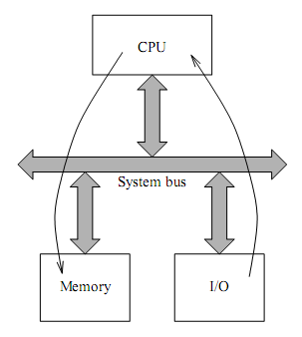
MODES OF TRANSFER
Modes of Transfer
3 different Data Transfer Modes between the central
computer(CPU or Memory) and peripherals;
Program-Controlled I/O
Interrupt-Initiated I/O
Direct Memory Access (DMA)
Program Controlled I/O

Slide 7
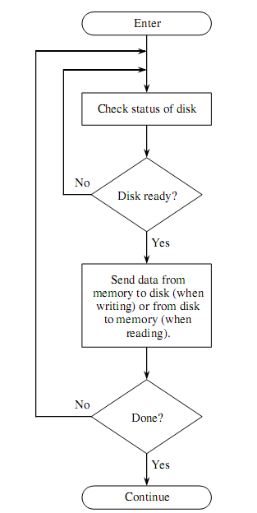
Programmed I/O
The benefit of using this approach is that we have programmatic control over the behavior of each device. Program changes can make adjustments to the number and types of devices in the system as well as their polling priorities and intervals.
Constant register polling, however, is a problem. The CPU is in a continual “busy wait” loop until it starts servicing an I/O request. It doesn’t do any useful work until there is I/O to process.
Owing to these limitations, programmed I/O is best suited for special-purpose systems such as automated teller machines and systems that control or monitor environmental events.

Slide 8
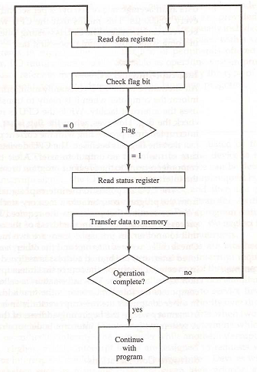
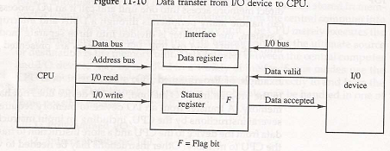
Example

Slide 9


